Slide 2
SWOG Clinical Trials Partnerships (SWOG CTP)
Update Forum
Kathy S. Albain, MD, FACP, FASCO
SWOG Vice-Chair for Clinical Trials Partnerships
Huizenga Family Endowed Chair in Oncology Research
Professor of Medicine, Division of Hematology/Oncology
Loyola University Chicago Stritch School of Medicine
Cardinal Bernardin Cancer Center
Casey Dawson
Director of Administration, SWOG-CTP
SWOG Cancer Research Network
Group Chairs Office OHSU Knight Cancer Institute
Crystal Miwa
Clinical Trials Project Manager, SWOG-CTP
SWOG Operations Office San Antonio, Texas; Ann Arbor, Michigan
Chrissy Laubach
Protocol Program Manager, SWOG-CTP
SWOG Operations Office San Antonio, Texas

Slide 3
Acknowledging SWOG CTP’s Executive Leadership, Scientific Advisory and Operations Expertise
CTP Executive Committee (Drs. Charles Blanke, Primo “Lucky” Lara, Michael LeBlanc, Dawn Hershman, and James Rae; Casey Dawson, Dana Sparks, Nathan Eriksen and Jo Horn)
Committee Chairs and Executive Officers (Partners/Advisory)
Scientific Advisory Board (SAB) (SWOG experts across all disease sites)
CTP Protocol Operations (Dana Sparks, Director; Crystal Miwa, Chrissy Laubach)
Administrative Assistance (Whitney Leslie, Valerie Durling)

Slide 4
SWOG CTP Update Forum Agenda
CTP and its Preferred Partnerships Program (PPP)
Joint CTP/Industry study development process
Executive Review Committee procedures and progress
Infrastructure and eResearch platform
CTP’s study portfolio – approved, in process, planned
CTP/AstraZeneca registration trial update
Milestones and vision

Slide 6
Mechanism whereby SWOG Cancer Research Network (1000+ member institutions) collaborates concurrently with industry as a preferred research partner
Offers range of study platform options (phases IB, IB/II, randomized II, III, registration)
Facilitates testing novel agents or combinations across disease sites or within a disease
Flows through dedicated CTP channels (study design, approval, development, contracting, monitoring, analysis, reporting)
Utilizes outstanding SWOG operations, statistics and data management personnel

Slide 7
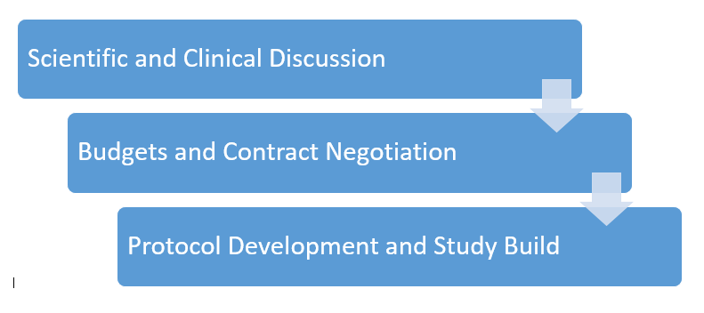
SWOG CTP process: joint study design and conduct with SWOG committees and industry partners

Slide 8
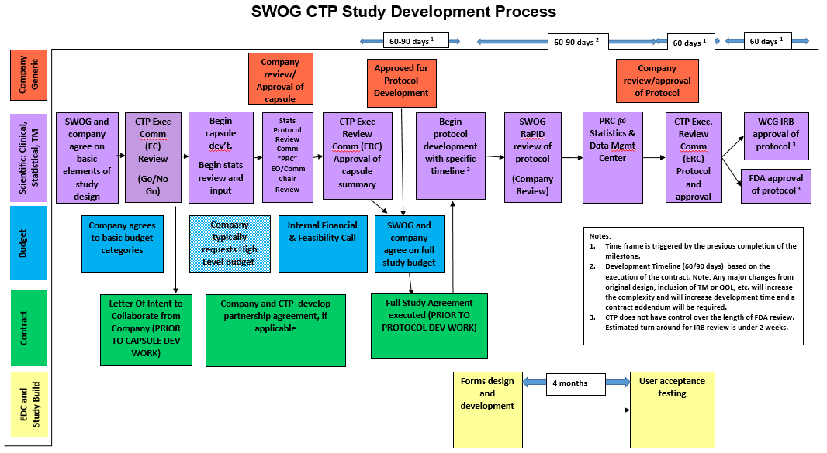

Slide 11
Go-No Go

Slide 13
SWOG CTP Executive Review Committee
“Replaces” NCTN Steering Committee reviews of initial capsule and subsequent full protocol (and requested revisions as needed)
Core group selected from CTP Executive Committee and Scientific Advisory Board, plus two ad hoc reviewers with project-specific expertise
New capsule template modeled after NCTN submission version, with CTP-specific Committee Chair, Executive Officer sections/other additions
Standardized voting process: open session with study team presentation including Lay Advocate, followed by closed session and vote

Slide 16
SWOG CTP Infrastructure and eResearch Platform - I
All SWOG sites will be notified of CTP studies close to activation to determine interest and accrual potential
Sites will need to complete a brief feasibility questionnaire
WCG (Western) IRB will be the central IRB for CTP studies
Banking SOPs (SWOG bank, institution banks, company banks)

Slide 17
SWOG CTP Infrastructure and eResearch Platform - II
CRAB Nebula Electronic Data Capture (EDC)
Integrated Clinical Trial Management System (CTMS) and electronic Trial Master File (eTMF) through Velos and Florence
These tools will streamline site communications and start-up efforts, house study documents, assist in management of Investigator Site Files (ISF), regulatory requirements, as well as monitoring and auditing

Slide 18
SWOG CTP Platform Designs in Development
Caveat: Unable to reveal compounds and details of designs in open sessions, per request of two of our active collaborators, pending final ERC approval and contract

Slide 19
Active Industry Collaborations*
Pending Collaborations
Acute lymphocytic leukemia
Breast cancer triple negative - adjuvant
Breast cancer ER+ HER2 - metastatic
Bladder cancer - neoadjuvant
Non-small cell lung cancer - metastatic
Head/neck squamous cell - advanced
*pipeline, platform, subtype
CNS Working Group
Digital Engagement
Immunotherapeutics
GI malignancies
Several company pipelines
SWOG VA Committee

Slide 20
First SWOG CTP Preferred Partnership
SWOG-CTP/Novartis Preferred Partnership Collaborative Master Agreement signed
Novartis pipeline (platform, basket, other designs; disease-specific or agnostic)
Solid tumor, hematology, immunotherapeutics, and early therapeutics/rare cancers
Hematology Franchise pipeline call first (next month)
Committee chairs and other SWOG scientific leaders will be included
Two platform trials jointly designed: 21CTP.LEUK01 (Ph+ ALL) will be submitted to CTP’s ERC next month and the other (MPN/MDS/CMML) on long pause awaiting trial readouts

Slide 22
SWOG CTP Platform Designs in Development
PARTNERSHIP: Lung Committee/Company X (+ partner biomarker company)
DISEASE CATEGORY: Platform (21CTP.LUNG01)
PATIENTS: Non-small cell lung cancer with typical EGFR mutations
PROJECT DESIGN: ctDNA-based decision-making, multi-cohort design with 2 agents finalized
STATUS: Letter of Collaboration Intent received; process followed, capsule approved by SWOG CTP Executive Review Committee; partner biomarker company secured; protocol development awaiting final contracting/budget approvals

Slide 23
SWOG CTP Platform Designs in Development
PARTNERSHIP: Breast Committee/AstraZeneca (+ partner biomarker company)
DISEASE CATEGORY: Platform (21CTP.BREAST01)
PATIENTS: Metastatic ER+, HER2-negative breast cancer on first line standard of care aromatase inhibitor plus CDK4/6 inhibitor
PROJECT DESIGN: Molecular match, study flow based on ctDNA status; if rising, randomized to multiple parallel arms with investigational agent/combinations
STATUS: Letter of Collaboration Intent received, collaborator for ctDNA studies secured; joint capsule development, revisions in progress; submission to ERC pending

Slide 24
SWOG CTP Platform Designs in Development
PARTNERSHIP: GU Committee – Bladder/Genentech (Tempus RNAseq platform partner)
DISEASE CATEGORY: Platform - Subtype (21CTP.GU01)
PATIENTS: First line muscle invasive, neoadjuvant
PROJECT DESIGN: Parallel cohorts defined by molecular subtype
STATUS: Letter of Collaboration Intent received; recurring operations and scientific calls, joint proposal development; agents and platform partner selected; submitted to and revised version approved by SWOG CTP Executive Review Committee; protocol development awaiting final contracting/budget approvals

Slide 26
SWOG CTP Platform Designs in Development
PARTNERSHIP: Head and Neck Task Force/Company Y
DISEASE CATEGORY: Platform 21CTP.HN01
PATIENTS: Metastatic squamous of head and neck and metastatic cutaneous squamous cell carcinoma (cohorts defined by type of/response to prior systemic therapies, if any)
PROJECT DESIGN: Parallel phase II cohorts with two agents
STATUS: Letter of Collaboration Intent received, capsule jointly designed and approved by SWOG CTP, Statistical Center PRC and industry partner
CTP ERC REVIEW: Requested revisions to a single arm phase IB/II for safety, given first in human doublet and in HN cancer only; capsule revised accordingly, resubmitted to ERC this month; assuming approval, protocol development pending contracting/budget approvals.

Slide 27
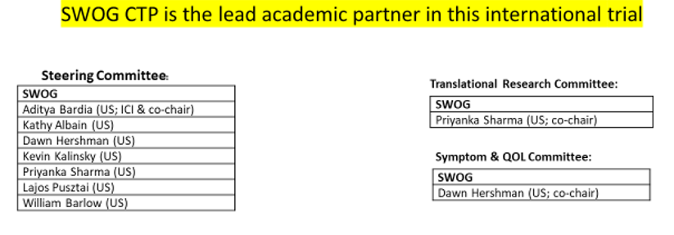

Slide 30
Approved by SWOG CTP Executive Committee
Approved by FDA
MSA and Statement of Work completed
Budget finalized
Attend Saturday’s Breast Committee meeting for details!

Slide 31
A SWOG CTP Task Force
Emerging opportunities with non-pharmaceutical interventions and tools
Stand-alone trials, or combined with therapeutic studies
CTP Task Force formed, meetings with industry in progress
Collaborations with SWOG Digital Engagement Committee and others

Slide 32
SWOG CTP Milestones and the Future
Successful development/implementation of internal processes (operations, administrative, contracting, statistical center, infrastructure and eResearch)
Upfront engagement among SWOG Committee chairs, SAB, industry partners and CTP leadership
Parallel study development & timeline process refined
Six projects reached capsule stage, with CTP Executive Review Committee approval in four to date
Exciting new initiatives to explore are pending with other companies – more interested partners are welcome!

Slide 33
SWOG CTP invites YOU to get involved!
PLEASE EMAIL CTP@SWOG.ORG WITH YOUR INTEREST,
APPLICABLE IDEAS, AND/OR INDUSTRY CONTACTS
For more information visit https://www.swogctp.org

Slide 34
SWOG CTP Update Forum
OPEN DISCUSSION

